Slide 1
Towards Real-time Crowd Simulation Under Uncertainty using an Agent-Based Model and an Unscented Kalman Filter
Robert Clay, Prof. Nick Malleson, Dr. Minh Le Kieu, and Dr. Jon Ward
https://github.com/Urban-Analytics/dust
Notes:
Name
Title
supervisors

Slide 2
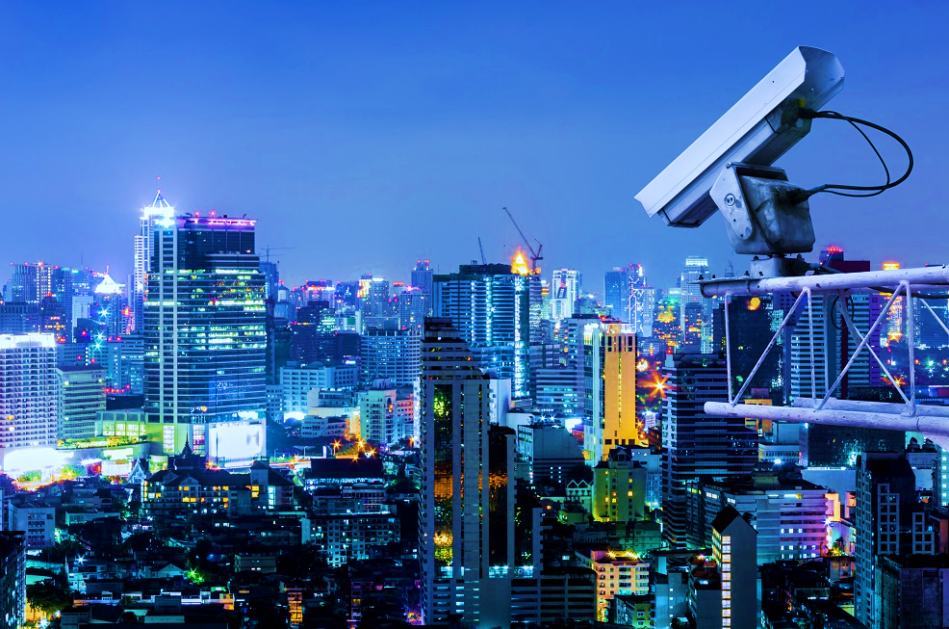
Notes:
Cameras,Gps,Rfid,footfalls
Smart cities aims to harness this big data into crowd and traffic predictions
These prediction used in urban infrastructure design to prevent over crowding and reduce traffic
Tech is relatively new and in its teething phase
One major stumbling block in SCs is uncertainty.
Much of the data gathered is unreliable, partial, or aggregated.
-cameras partial unreliable
-Footfall counters - aggregated
-gps unreliable/partial e.g. underground
Wish to quantify uncertainty to identify a bad camera and incorporate into prediction

Slide 3
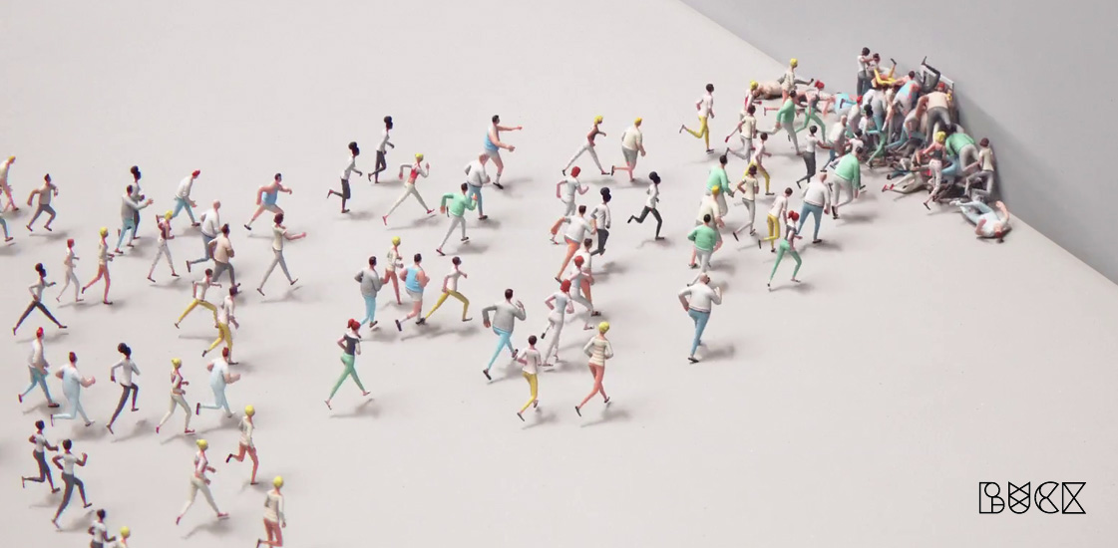
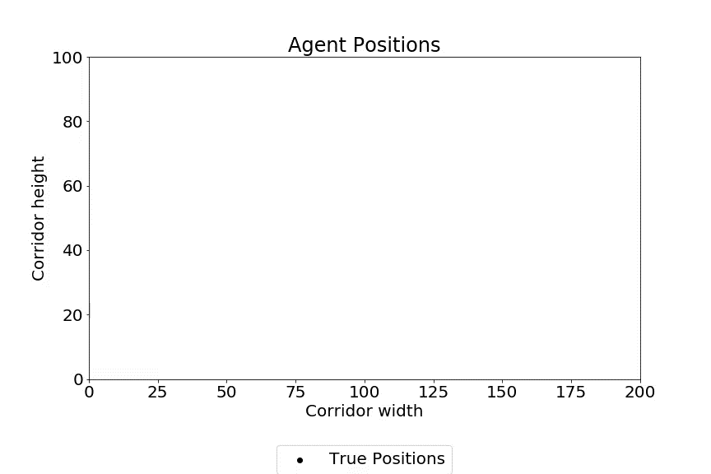
What are Agent-Based Models?
Notes:
Abm explaination
Stationsim explaination
Aim to go from noisy partial data into smooth consistent paths
Do this using data assimilation

Slide 4
Data Assimilation (DA)
t
t + 1
Predicted
Assimilated
Observed
Notes:
Da explanation.
Idea of blending naïve prediction with noisy observations into more smooth consistent paths
First predict whats happening. this estimate of the next state comes from ABMs
Then observe from some sensors whats happening
Then blend the two together to get an estimated compromise of whats happening.

Slide 5
Ensemble Data Assimilation
Commonly used techniques such as Particle Filtering and Ensemble Kalman Filtering.
Robust and accurate but computationally expensive.
The Unscented Kalman Filter is proposed as a more efficient alternative.
Notes:
ABMS seen lots of DA applicton
SS no exception
We have used pf and enkf to great effect already
These methods are accurate, robust, and flexible (work with a lot of data)
However their computational expense fuels motivation for more efficient methods

Slide 6
Notes:
Go back to data
Wish to aggregate already noisy/partial data to induce further uncertainty

Slide 7
Missing Data Experiment
- The aim of this random omission is to emulate a crowd where only some proportion of people are tracked.
- Some agents are fully observed, and some are only observed as they enter the model.

Slide 8
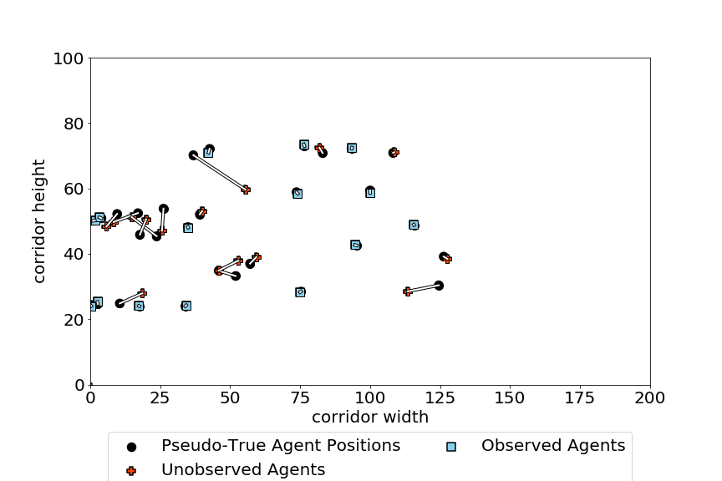

Slide 9
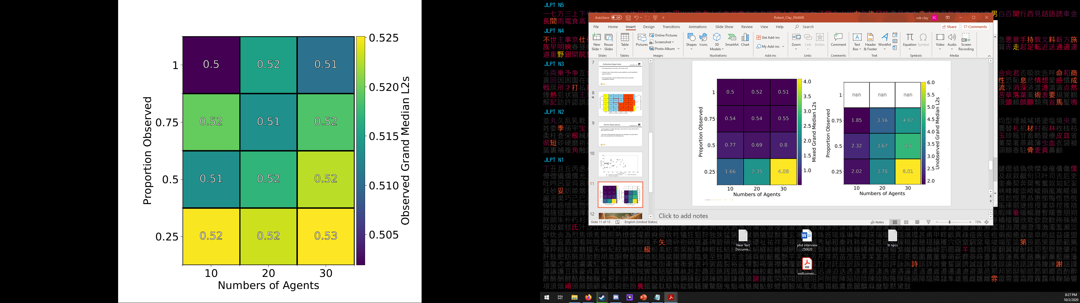
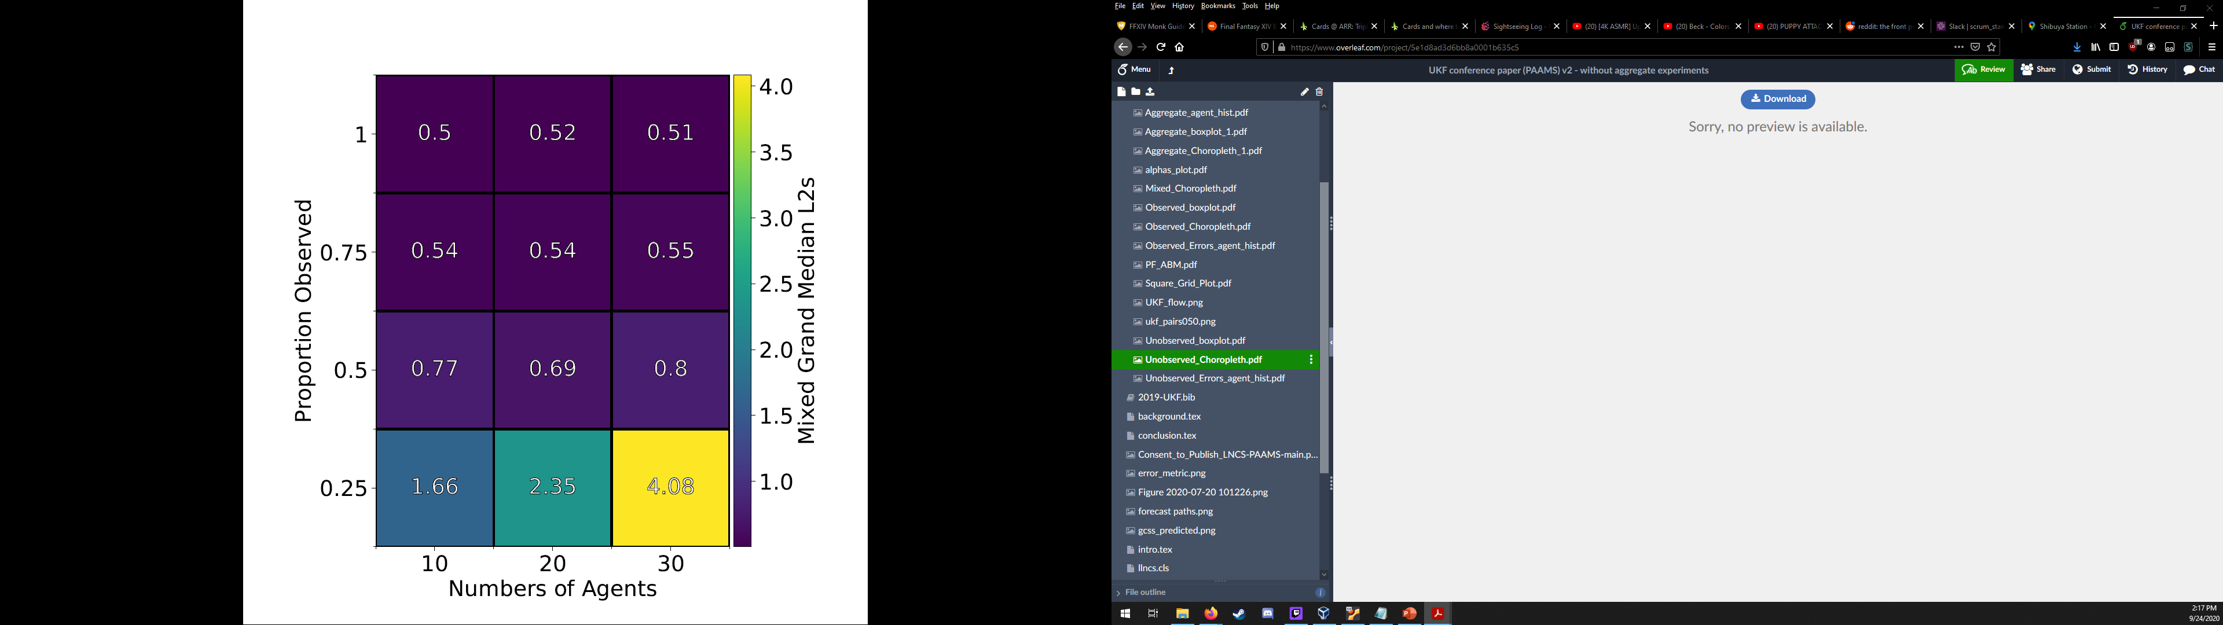
Observed Agents
Observed Agents
Both Observed and Unobserved Agents

Slide 10
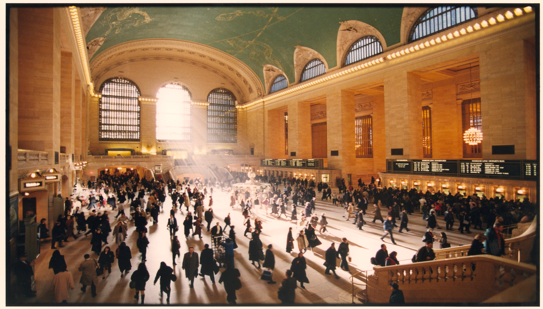
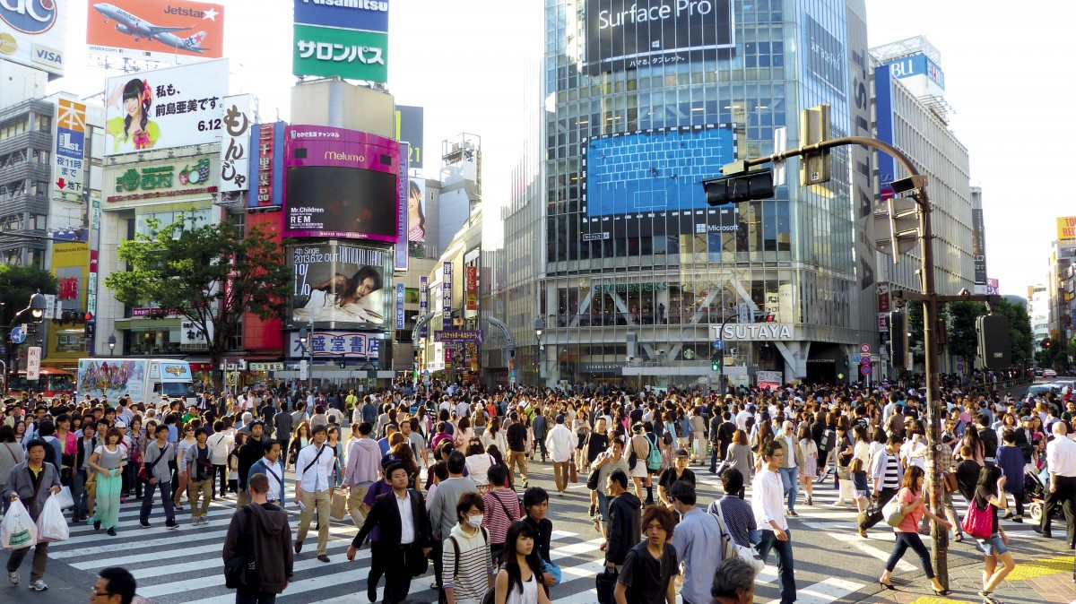
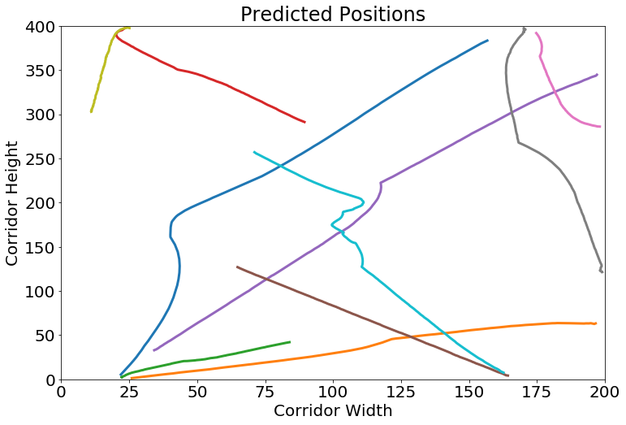
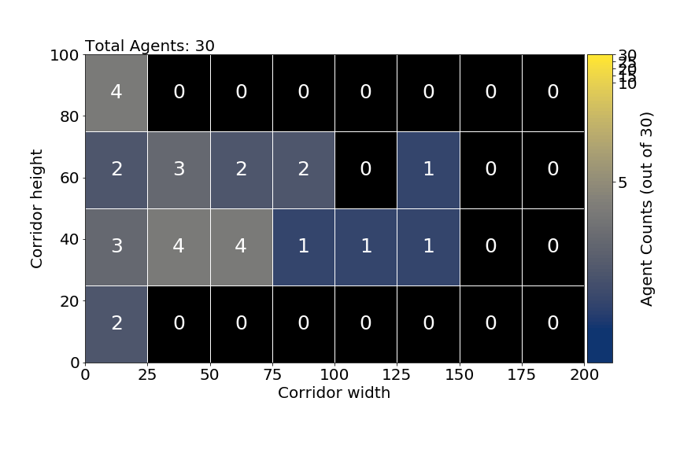
Notes:
Summary
Presented ukf as efficient alternative
Presented one scenario in which ukf can be applied to aggregate data
Further Extensions to UKF (AUKF, AUEKF)
Further state spaces sensor fusion etc.
Comparison to Other Techniques (PF,EnKF)
More complicated topologies/abms
Application to Real data
Long term goal of digital twinning
Can we apply this to whole train stations/cities in urban infrastructure design?
Can we test a new design in the event of a fire or terrorist attack without laying a single brick?

Slide 11
Thank you for you time.
Robert Clay – gyrc@leeds.ac.uk
Prof. Nick Malleson – n.s.malleson@leeds.ac.uk
https://github.com/Urban-Analytics/dust

